Slide 1
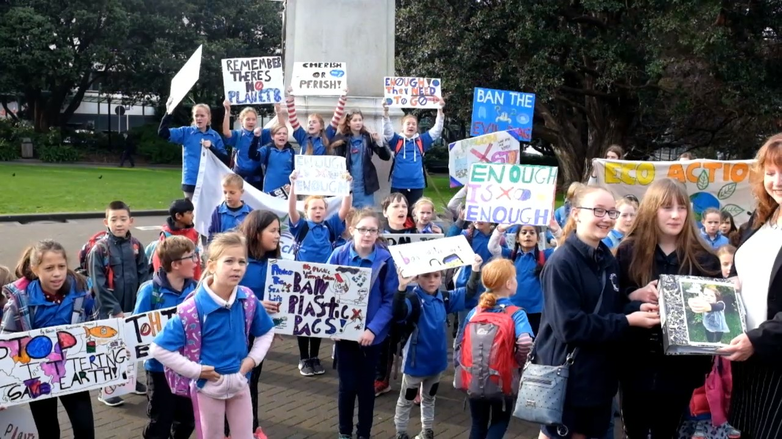
Social studies education in NZ – where are we at?
Education Hub
7th November 2024
ASsoc Prof Bronwyn Wood
Victoria University of Wellington, Te Herenga Waka
Bronwyn.wood@vuw.ac.nz

Slide 2
Overview
Part I: Where are we at right now?
PART II Effective social studies approaches
Understanding and planning through concept-led teaching
An example of planning using concept-led teaching
Part III Progression in social studies

Slide 3
PART I: Where are we at right now?

Slide 4
NZ Curriculum reform – 2019 - now
2024 Draft
2007-now?
2022 Draft – now removed
2024 Draft

Slide 5
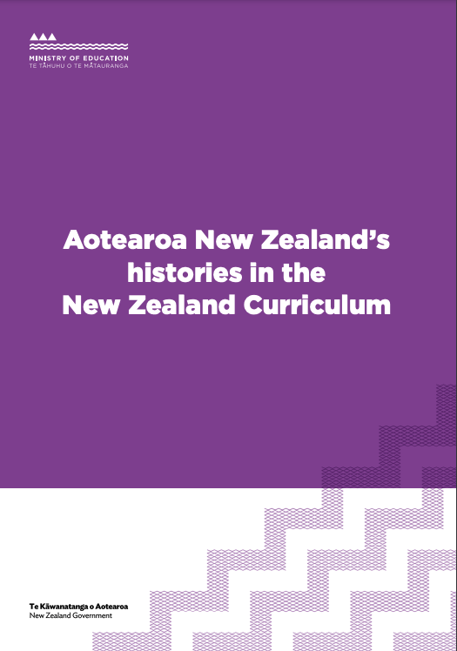
Social science curriculum reform
Began with History 2020 – released in full Nov 2022 - implemented in schools 2023
Social sciences – released Nov 2022
Draft Te Mātaiaho released Nov 2022

Slide 6
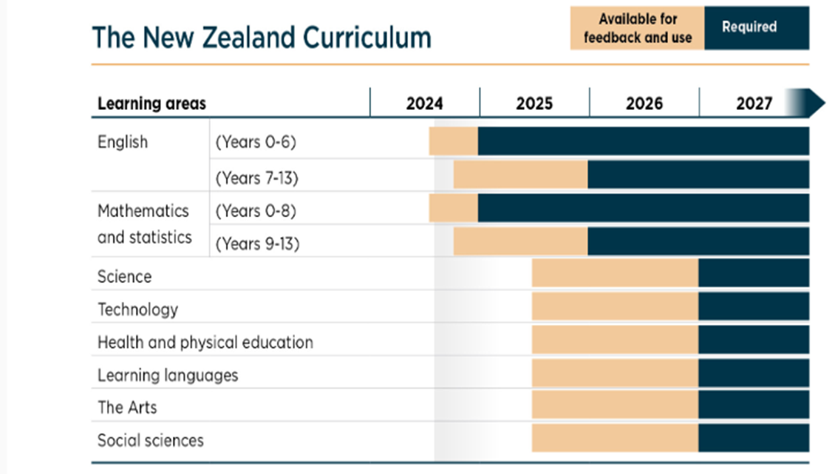

Slide 7
Holding a line…..
Tendency in educational and curriculum reform toward polarising swings
Reflective of political ideologies (esp progressive and conservative)
Can result in a ‘baby out with the bathwater’ effect
Long-seated dichotomies in education
Teaching | Learning
Knowledge | Skills
Teacher-led | Student-led
Global | Local

Slide 8
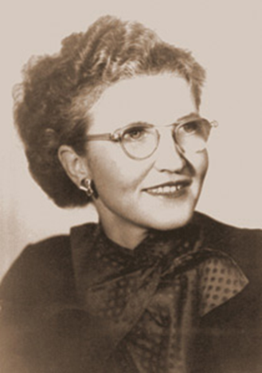
Taba’s social studies curriculum
Breaking down the organisation of subject matter into three levels
Key concepts = e.g. cultural change, power | Organising ideas (conceptual understandings) | Specific facts
‘Because of their power, such concepts can be developed into an increasingly abstract and complex manner throughout the curriculum.’ | Selection of effective topics on the grounds of Significance Explanatory power Appropriateness Durability Balance (Taba, Durkin, & Fraenkel, 1971): | Case studies and illustrations to develop the idea
Fraenkel, 1992
Notes:
We already have may clues about effective social studies teaching and learning from a long history in social studies and also a growing body of research.

Slide 9
PART II Effective social studies approaches
Understanding and planning through concept-led teaching An example of planning using concept-led teaching

Slide 10
Twin goals of SST education
Goal 1: Understanding the world
From a variety of (social science) perspectives
Developing conceptual knowledge and skills to understand society
Goal 2: Effective participation as citizens
A range of skills that include well-formed critical thought and analysis, understanding of values and empathy and respect for others
Commitment to democracy
Barr, 1998 (The nature of social studies)

Slide 11
Two key approaches to effective social studies outcomes
Knowledge
Teaching through concepts
Conceptual understandings
Skills
Asking questions
Research – collecting, analysing and communicating
Mapping, graphing etc
Identifying values and perspectives
Analysing decisions, taking social action

Slide 12
Social inquiry skills in social sciences – TM Curriculum Do’s
Asking questions | Thinking conceptually | Identifying values and perspectives | Collecting and analysing information Communicating ideas | Analysing decisions and taking social action
Learning to ask critical questions about social issues | Defining concepts and learning to apply them in multiple contexts and with other concepts | Gaining understandings that not all people think the same; How to evaluate and navigate between different perspectives. | Gaining skills of researching, evaluating sources and quality and truth (critical literacy) and communication (literacy and critical thinking) | Evaluating and problem-solving; Asking so what? Now what? Considering social actions

Slide 13
What are concepts?
Concept = an idea or notion
Usually phrased as one or two words
e.g. decision-making or needs
It is NOT a place, person or event.
Concepts are mental constructs that are abstract, timeless and universal (Erickson & Lanning, 2014, p. 33).
Concepts are words which represent highly abstract generalisation (Taba, 1964)
Notes:
13
It needs to be complex enough to warrant attention at a particular year level. E.g. needs is less appropriate for

Slide 14
What are conceptual understandings?
A generalisation about a concept i.e. when a concept(s) is used in a statement.
Sometimes referred to as ‘Big Ideas’
E.g. Values of people and groups influence their view and use of places and environments.
Most Achievement Objectives in the 2007 curriculum are based on conceptual understandings
(KNOWS in the NZC Refresh and reinforced as ‘Thinking conceptually’ in the DO’s with progressions indicated clearly) (2022)
NCEA Standards in senior SST require conceptual understandings (today)
See free chapter – concept-based curriculum design
https://indico.cern.ch/event/803074/attachments/1832310/3001950/82739_Chapter_1___Tools_for_Teaching_Conceptual_Understanding_Secondary.pdf
Notes:
14
Current curriculum uses concepts and conceptual understandings – but phrases them as a question.
Deep knowledge transfers across cultures and provides conceptual structure for thinking about related and new ideas (Erickson (2002, p. 7).

Slide 15
Teaching through concepts

Slide 16
What is the social studies aspect of this context? Concepts?

Slide 17
What is the social studies aspect of this context? Concepts?

Slide 18
What is the social studies aspect of this context? Concepts?

Slide 19
To what extent do concepts currently drive your social studies/social sciences teaching ?
Notes:
Prize for identifying the most changes/shifts

Slide 20
Strategies for teaching for conceptual understandings
Concept sort – into ‘like’ piles
Concept wall – to build up to one over-riding concept
Concept map – to show linkages and relationships between concepts
Concept Arrow - explain relationships between concepts – e.g.
Cultural change
Migration

Slide 21
An example of a student CD-Map about choices (Year 8)
Comparison term
options
Defined as
Options you have
Opinions people have of a range of options
Things you have to decide on in life
The power to choose between
A variety from which one can choose.
Can lead to…
a conclusion of what to do
A happy end
Objective argument
choices
Examples:
Choosing what you wear
Choosing what colours you wear
Associated with:
Colour
Life
Houses
Art
food

Slide 22
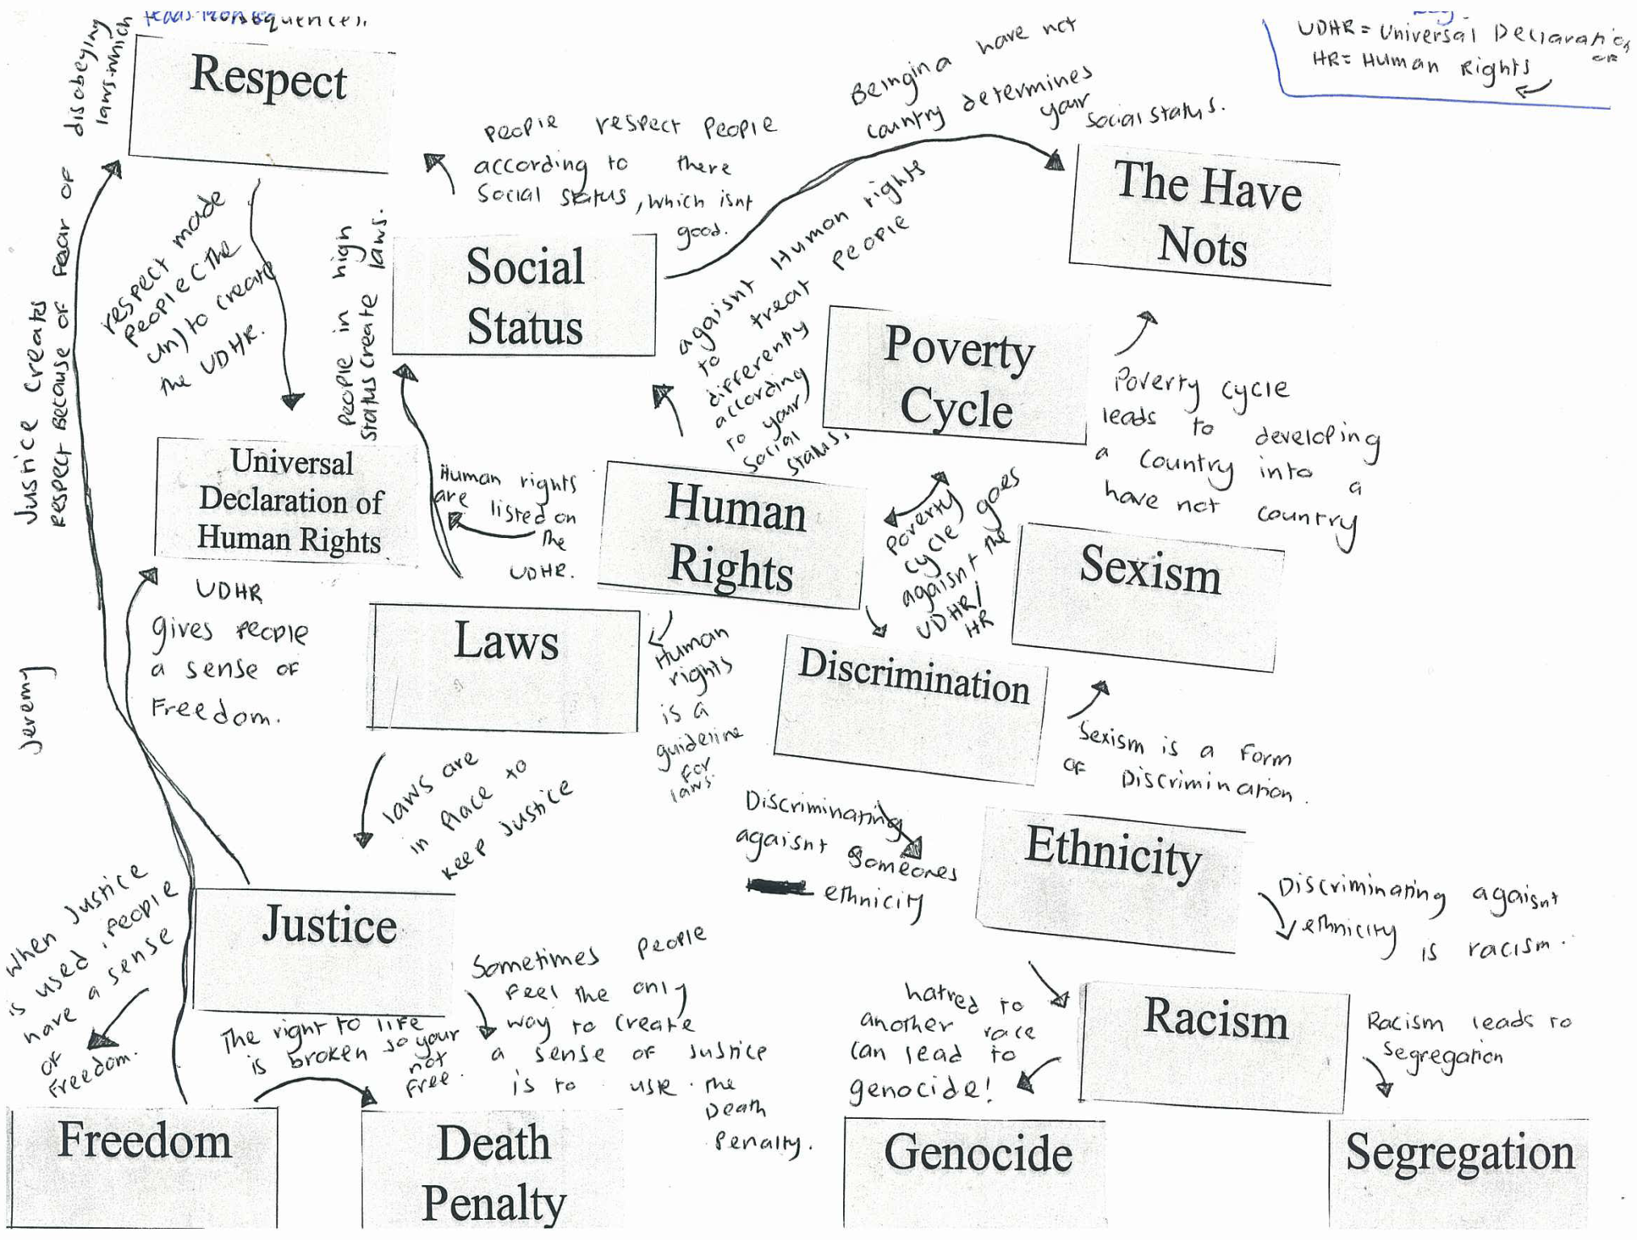
What is strong in this student example and what needs further support?
Student work NCEA Decile 1 school
Notes:
Some points learned during this exercise:
Too many concepts
Most understandings were at definition stage;
Some understandings showed higher level application e.g. Sometimes people feel…

Slide 23
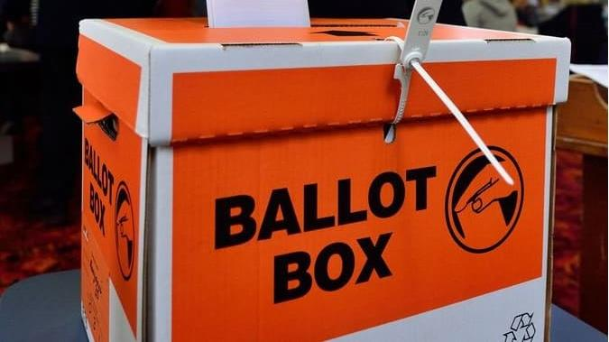
Who gets to vote?
Notes:
Who gets to have a say? (in our democracy)

Slide 24
Significance for social studies
The right to vote is foundational to democratic processes
The history of the vote is contested and various groups have been excluded and marginalised through time
NZ was the first nation to give women the vote in 1893
Māori have asserted aspects of tino rangatiratanga for representation and the right to vote over time.
The ability to vote is still contested - young people today are lobbying for the vote.

Slide 25
Conceptual focus: Government and organisation
2007 Curriculum | 2023 Social Sciences curriculum (Te Mātaiaho) Year 9-10
Understand how systems of government in New Zealand operate and affect people’s lives, and how they compare with another system. | Systems of government and justice differ in the ways the operate and in how they affect people’s lives.
Understand how people define and seek human rights. | Together, people assert their human rights and attempt to persuade the state and organisations to respond.
 | ANZ Histories: The Crown asserted its power to establish a colonial state that in consequence diminished the mana of Māori. Over time, Māori have worked inside, outside and alongside the Crown to renegotiate the colonial relationship with the Crown and to affirm tino rangatiratanga.

Slide 26
Key question: how have people sought representation in governments? Concepts
Representation
Aligned concepts
Systems of government
suffrage, participation; human rights
Aligned concepts
democracy, justice, mana, power, colonialism

Slide 27
Suffrage dates in NZ
Did you know…
Saudi women were given right to vote (and drive) in 2011
Aboriginal and Torres Strait Islander people given right to vote 1962
Date
1852 Constitution Act | Only males over the age of 21 who owned, leased or rented property of a certain value could vote.
Māori Representation Act 1867 | Established 4 Māori Seats in the House of Representatives – giving all Māori males over 21 the right to vote
1879 | Universal suffrage for all Males over 21
1893 | Universal suffrage for all women over 21
1952 | Chinese vote – only could vote once they could receive ‘naturalisation’ (citizenship) – banned from this from 1908
1969 | Voting age reduced to 20
1974 | Voting age reduced to 18
202? | Voting age reduced to 16??????

Slide 28
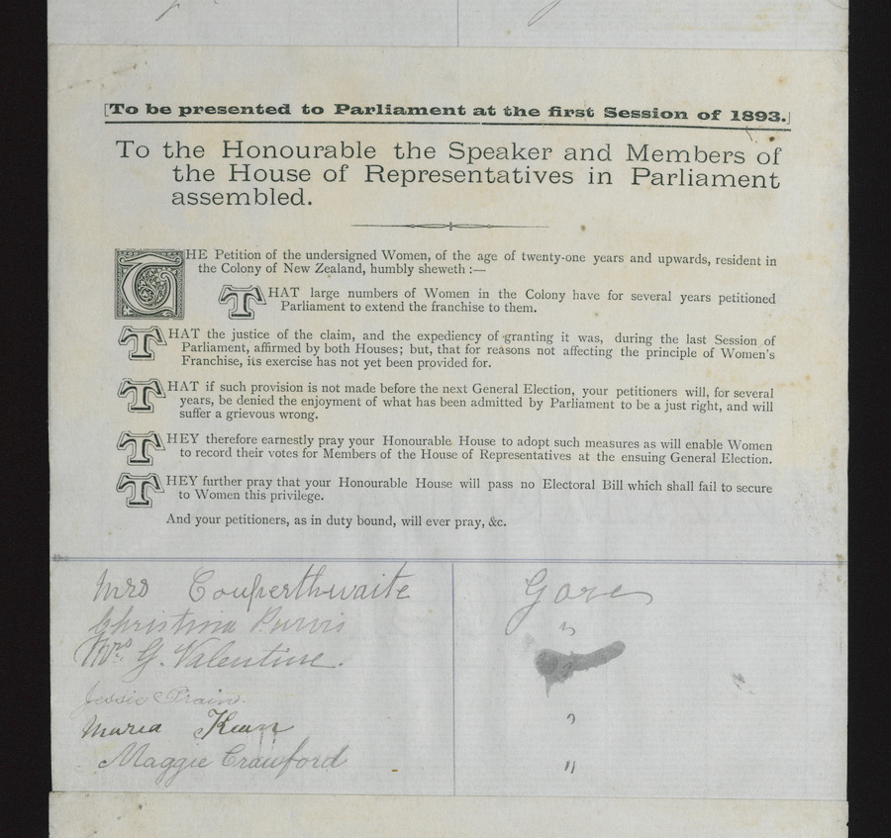
Supporting literacy
Key vocab
For example, ballot, elections, suffrage, franchise, petition, protest, voting,
Identify the vocab students will need to know
Use ESOL Online strategies to support vocabulary
E.g.
Before and after vocabulary grid
Word matching exercises
Loopy (game)
Notes:
https://esolonline.tki.org.nz/ESOL-Online/Planning-for-my-students-needs/Resources-for-planning/ESOL-teaching-strategies/Vocabulary

Slide 29
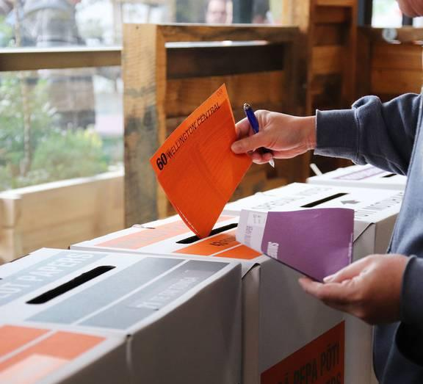
Four case studies
Māori suffrage
Women’s suffrage
Chinese suffrage
Make-it-16

Slide 30
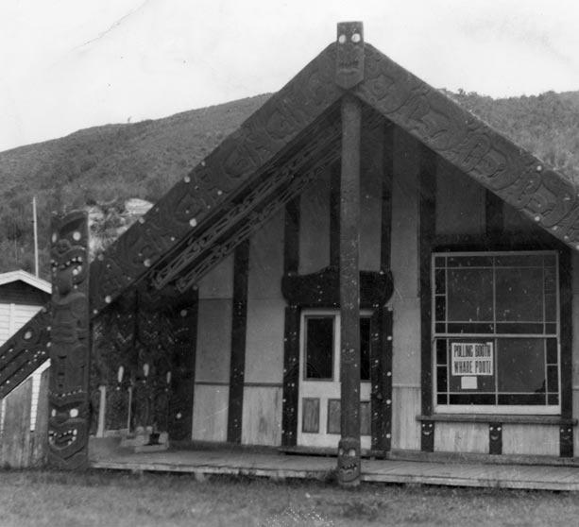
Māori and the vote
1987 Māori Seats established
https://nzhistory.govt.nz/politics/maori-and-the-vote
Current debates about Māori roll, seats, and Māori seats on Council.
Representation
Suffrage
Notes:
Although New Zealand's 1852 constitution was theoretically colour-blind, very few Māori were able to vote in early elections because they owned their lands communally. The wars of the 1860s fuelled debate about Māori representation, and in 1867 four parliamentary seats were set up specifically for Māori. As a result of this legislation, Māori men achieved universal suffrage 12 years before European men.

Slide 31
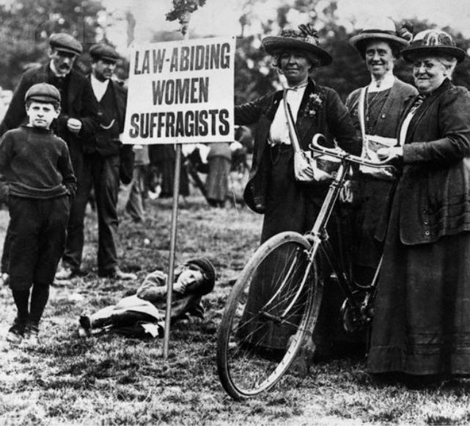
Women and the vote
https://nzhistory.govt.nz/politics/womens-suffrage
Kate Shepherd National Memorial – Christchurch, 1993
https://www.ccc.govt.nz/culture-and-community/heritage/womens-suffrage
Contemporary places where women have restricted voting rights e.g. Afghanistan
Representation
Suffrage

Slide 32
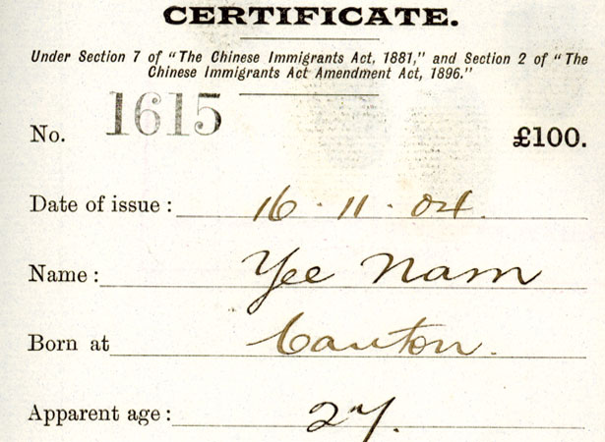
NZ Chinese and the vote
New Zealand Chinese - declined ‘naturalisation’ (citizenship) from 1908 till 1952
Highly racist ‘poll tax’ imposed 1881 to restrict access/immigration (to Gold fields primarily)
During this time could not vote as they could not be citizens
Poll tax waived 1934 – but not repealed till 1944
1951 Government permitted the naturalisation of Chinese
2002 NZ Govt officially apologised to Chinese community
Representation
Suffrage

Slide 33
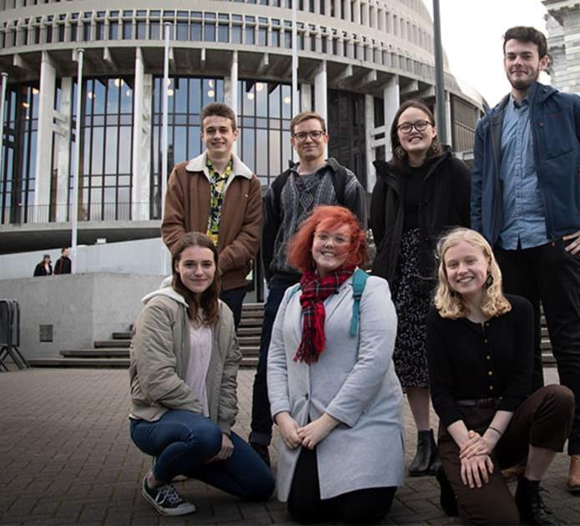
Make-it-16 campaign
https://www.makeit16.org.nz/
https://nzhistory.govt.nz/te-akomanga/contexts-activities/should-voting-age-be-lowered-to-16
https://www.rnz.co.nz/national/programmes/the-house/audio/2018849880/make-it-16-gains-traction-at-youth-parliament
Representation
Suffrage

Slide 34
Make-it-16 campaign
Make it 16 was founded out of the 2019 Youth Parliament where it received support from across the house.
2020 High Court case – argued law was discriminatory based on age under Bill of Rights – not upheld (found it was discrimination but agreed with Attorney-General that it was justified)
August 2021 Court of Appeal case – not upheld
June 2022 Ghahraman’s Member's Bill, the Electoral (Strengthening Democracy) Amendment Bill drawn from the biscuit tin and set for consideration by MPs.
Local Government NZ trialled a Youth Vote experience as part of elections September 2022
August 2023 First part of Voting Age Bill passed in Parliament to allow 16-17 year olds to vote
2024 Withdrawal of Voting Age Bill.

Slide 35
Multiple perspectives about voting at 16
Group | Position | Reason
Make-it-16 | Pro 16 and 17 year olds voting | The current voting age of 18 is unjustified age discrimination and that the High Court should declare it inconsistent with the Bill of Rights Act. "For us we just really want to see 16 and 17-year-olds have a voice in democracy and it's a human rights issue and that's not something we can just give up," -Rennie
Green Party | Pro 16 year olds voting | MP, Golriz Ghahraman, expressed her support for a lower voting age by proposing a member’s bill on electoral reform.
Labour Party | Uncommitted - Ardern declined to give position | "I wouldn't rule it out in the future but let's get civics right first, let's support our young people to learn about politics"
Children’s commissioner Andrew Becroft (2018) | Calls for a genuine discussion | "If they voted and had a lobby, I'm quite convinced that our policy for under 18-year-olds would significantly improve.”
National Party – Nicola Willis | Against | It's widely accepted 18 is the age of adulthood. "Voting is a wonderful responsibility and it's a rite of passage but I think we've got it about right having it at 18.“16-year-olds would be ‘potentially vulnerable to parental coercion.’
Using a jigsaw group approach, establish the interest and reasons of each of these stakeholders

Slide 36
Student work – survey of 5 people’s opinions on 16 and 17 year olds voting
Student A Individual – Position - Reason | Assessment
Mum – Against – Not all 16 year olds understand the decision they are making when it comes to voting. They could be influenced by there friends vote, 16 year olds might not take it seriously. Tania – Against – not enough life experience. Uncle Laurie – Neutral – Not mature enough. Zoe – For it – when your 16 you can drive, leave home, leave school, work full time. | Thinking conceptually – some understandings of contested idea of the right to vote – lacks specific details, examples to show depth Communicating ideas – Student A could accurately plot responses on a values continuum; Very weak evidence given for perspectives – not explored and not enough detail. Literacy – simple errors in spelling, grammar and punctuation. Highlighted in blue.
Kate Sheppard and Make it 16. Both were try to achieve something. Make it 16 is like when Māori were called stupid and other rude things. Its like what some people called 16 year olds. Women weren’t allowed to vote as they were meant to take care of thing around the house hold and men thought they didn’t have enough knowledge to vote. 16 year olds are referred to as stupid and imature other things but some 16 year olds are very mature and have enough knowledge to know what voting is.
Student work from Craighead Diocesan School, Timaru

Slide 37
Any questions?

Slide 38
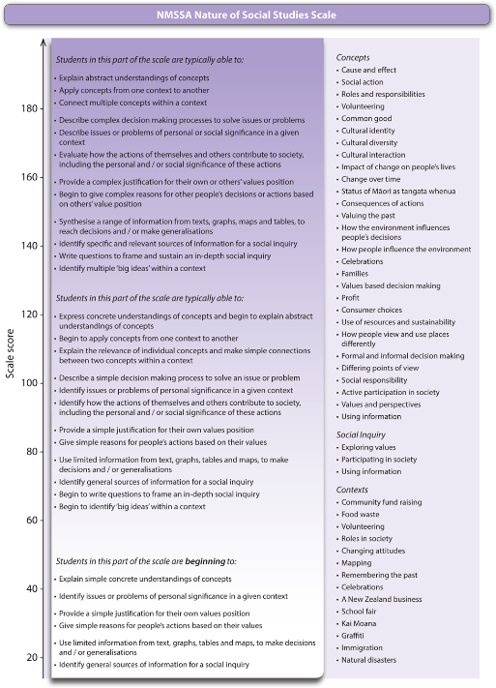
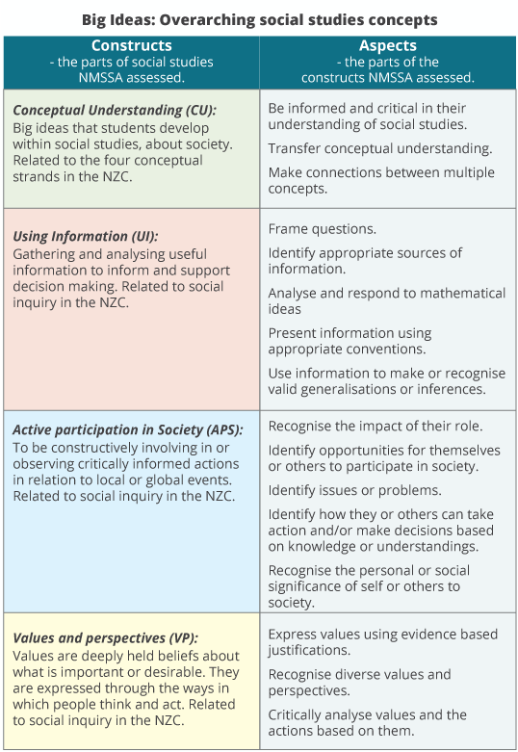
Scale of progression used by the NMSSA study – see https://nmssa.otago.ac.nz/insights/INSIGHTS_SocialStudies_2018.pdf

Slide 39
NZc Refresh 2023 – progression with concepts – Thinking conceptually
In my learning in te ao tangata | social sciences, I can:
By end of Year 3 | By end of year 6 | By end of year 8 | By end of year 10
define some social science concepts and explain how they relate to an investigation. | define and explain concepts that are relevant to what I am learning about, using relevant examples. | make connections between concepts by exploring different contexts. | apply conceptual understandings across contexts and case studies in order to develop generalisations explain that concepts are contested and mean different things to different groups.
See https://ssol.tki.org.nz/Social-sciences-1-13/Social-sciences-1-10/Teaching-and-learning/Effective-teaching-in-social-sciences/Building-conceptual-understandings
Notes:
Approaches to building conceptual understandings
Student ability to:
1. List, sort, and label and define concepts
2. Identify further examples and non-examples
Construct links between like-concepts. For example, ask students to show relationships between concepts in a context of learning
3. Demonstrate connections between multiple concepts
Explore the relationships between concepts and how they are linked. Select ‘bundles of concepts’ around a conceptual understanding and encourage students to explore their understanding of connections between these concepts.
4. Transfer conceptual understanding to previously unseen/unknown examples
Apply the concept to new/unrelated contexts
5. Taking action/making decisions based on new knowledge and understandings
Use their knowledge of the concept in a meaningful context to generate solutions to problems; make decisions; participate.
6. Identifying a range of ways in which the concept may be interpreted
Explore ways a concept means different things to different groups of people.
Using social studies perspectives, select contexts where there are conflicting values and understandings of a theme or issue.

Slide 40
https://confer.eventsair.com/soccon-2025/

